Slide 1

COVID Impact on Parcel Industry
Nikhilesh Divyakumar Patel Bryan K Tomichen
Prof : Abu Hena Al Muktadir
Date :22-04-2025

Slide 2
Objective
Through this analysis, we aim to:
See how parcel volumes and revenue changed during the pandemic period.
Pinpoint the timeline of key shifts in customer activity.
Understand which customer segments (like Enterprise, Large, Medium, and Small businesses) were most affected.
Offer practical suggestions to help the company plan future strategies based on the data.
The main goal of this study is to explore how the COVID-19 pandemic influenced ABC Company’s parcel delivery business. Specifically, the focus is on understanding when customer volumes were first affected, what major events might have contributed to those changes, and how the company’s performance varied across different types of customers.

Slide 3
COVID-19 Timeline & Customer Volume Impact
In early 2020, ABC Company began to see noticeable changes in customer parcel volumes. The most significant drop occurred around March 2020, which aligns with the initial wave of lockdowns and travel restrictions put in place due to the COVID-19 outbreak.
As the year progressed, parcel volumes gradually began to rise, especially as people turned to online shopping more frequently. The peak season during November and December 2020 showed a strong surge in volume, driven largely by eCommerce activity and holiday shipping demands.
These shifts were directly tied to key events during the pandemic and had a major influence on business performance throughout the year.

Slide 4
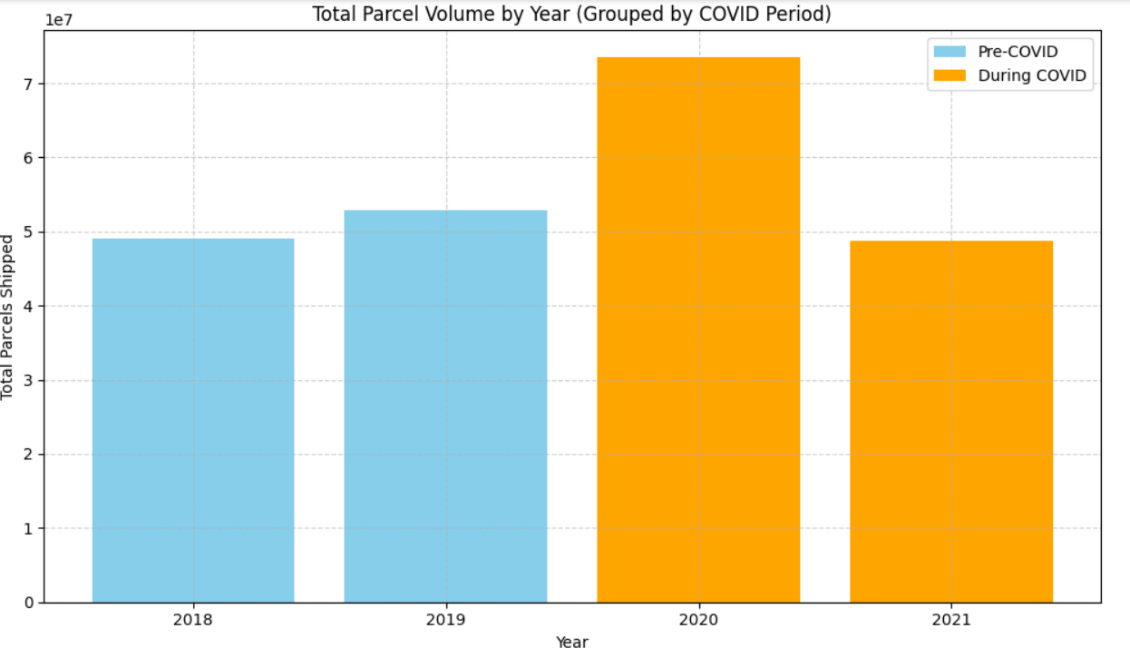
Overall Parcel Volume by Year (2019–2021)
In 2019, parcel volumes were consistent, reflecting a stable market environment.
A significant change is observed in 2020, coinciding with the start of the COVID-19 pandemic, suggesting shifts in consumer behavior and logistics demand.
2021 continued to reflect elevated volume levels, indicating possible long-term effects of the pandemic on parcel delivery patterns.

Slide 5
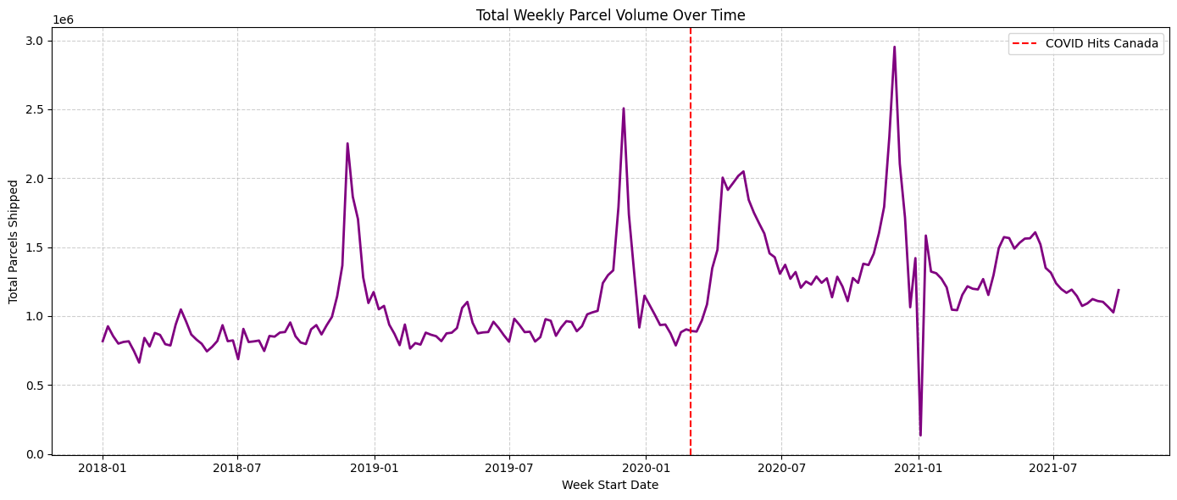
Analysis of Monthly Sales
A noticeable dip in volume occurred around March–April 2020, aligning with the initial COVID-19 outbreak and lockdown measures.
From mid-2020 onward, parcel volumes rebounded sharply, likely due to increased online shopping and shift in consumer habits.
Volumes remained consistently higher in 2021, indicating a permanent shift in logistics demand.

Slide 6
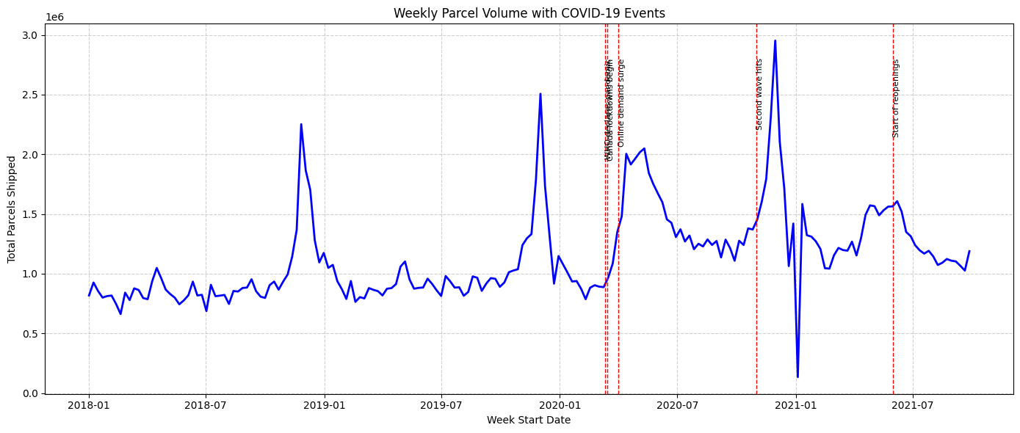
Impacted Customer Volumes Analysis
The first major drop in parcel volume occurred in March 2020, correlating with the announcement of COVID-19 as a pandemic and the first national lockdown (March 2020 – May 2020).
Parcel volumes began to rebound in June 2020, following the gradual reopening of businesses.
A second lockdown during November 2020 – February 2021 coincided with a seasonal surge, suggesting stronger online holiday shopping despite restrictions.
A third wave lockdown in April – June 2021 did not significantly reduce volumes, indicating that customer behavior had fully shifted to digital channels.

Slide 7
Major Events and Their Impacts
March 11, 2020 – WHO declares COVID-19 a pandemic
→ Immediate dip in parcel volume due to panic, lockdowns, and halted operations.
March–May 2020 – National lockdown (1st wave)
→ Decline in business activity and B2B shipments, but early signs of residential e-commerce growth.
June 2020 – Gradual reopening
→ Surge in online orders and parcel delivery as people adjusted to stay-at-home lifestyles.
Nov 2020 – Feb 2021 – Second wave lockdown
→ Holiday peak season amplified by COVID-related online shopping spike.
April – June 2021 – Third wave restrictions
→ Volume remained stable or grew, indicating long-term change in customer behavior.

Slide 8
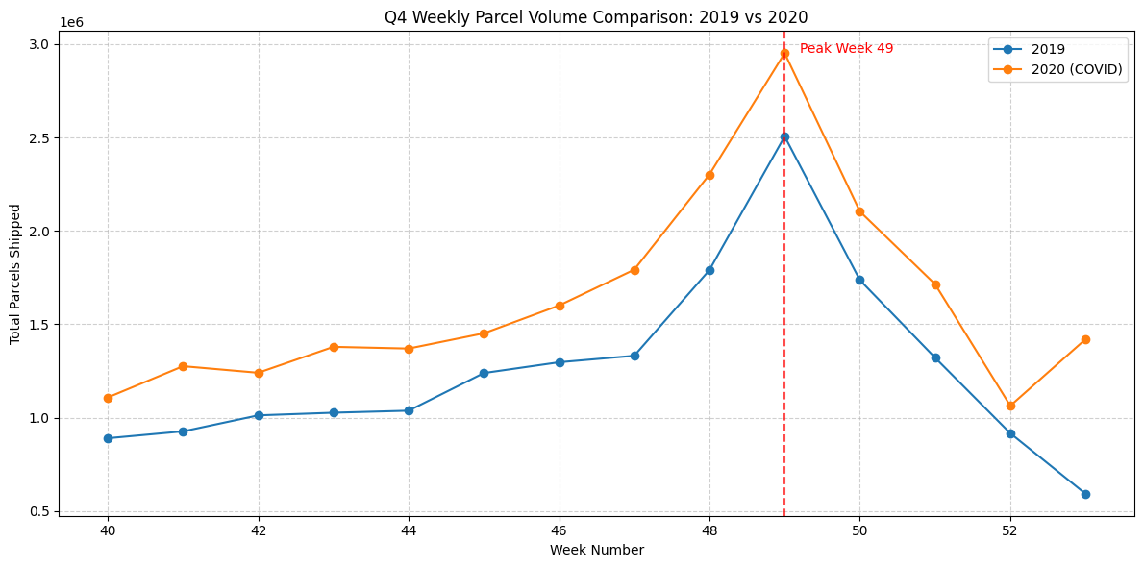
Impact on Peak Season (Q4) from 2018–2020
Growth from 2018 to 2019: +6.9%
Growth from 2019 to 2020: +29.2% (COVID period)
Year | Total Parcel Volume (Q4)
2018 | 16,492,336
2019 | 17,623,860
2020 | 22,776,351

Slide 9
Impact on Parcel Volume by Customer Segment
Enterprise and Large customers saw noticeable volume decreases.
Medium and Small categories remained relatively stable.
Small segment grew slightly, suggesting adaptability during pandemic.
Inactive customers became active during COVID — indicating new business or delivery models emerged.
Customer Category | Pre-COVID Volume | During COVID Volume
Enterprise | 14.16M | 9.45M
Large | 10.65M | 8.55M
Medium | 4.88M | 4.14M
Small | 2.14M | 2.26M
Inactive | 0.02M | 0.06M

Slide 10
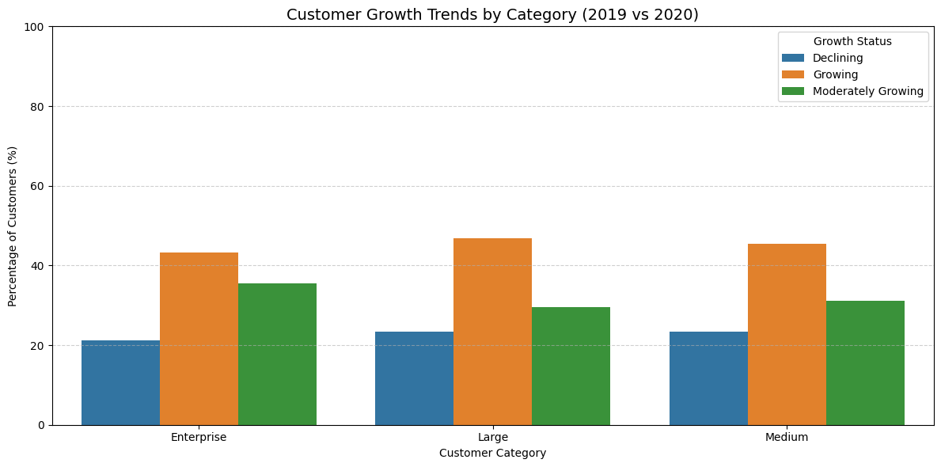
Customer Growth and Decline Analysis
Across all customer segments, over 40% showed growth, with Medium and Large segments performing best.
A smaller share of customers, around 22–24%, were in decline.
Moderate growth remained consistent, averaging around 30–35% per segment.
These insights show that many customers adapted their logistics and delivery models effectively.

Slide 11
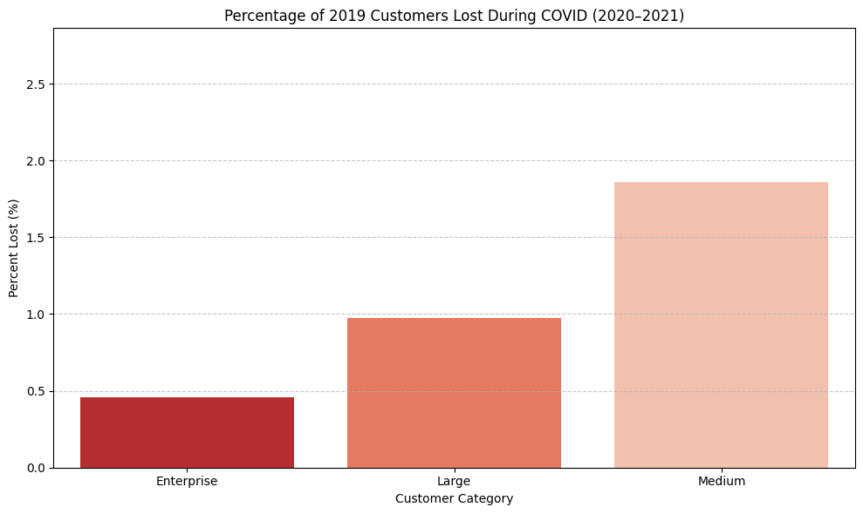
Percent of Customers Lost by Category
Enterprise segment saw the lowest customer churn (~0.45%).
Large customers had a slightly higher loss rate (~1%).
Medium customers were most affected, with nearly 1.9% lost during the pandemic.
Indicates that larger customers were more stable or retained more effectively.

Slide 12
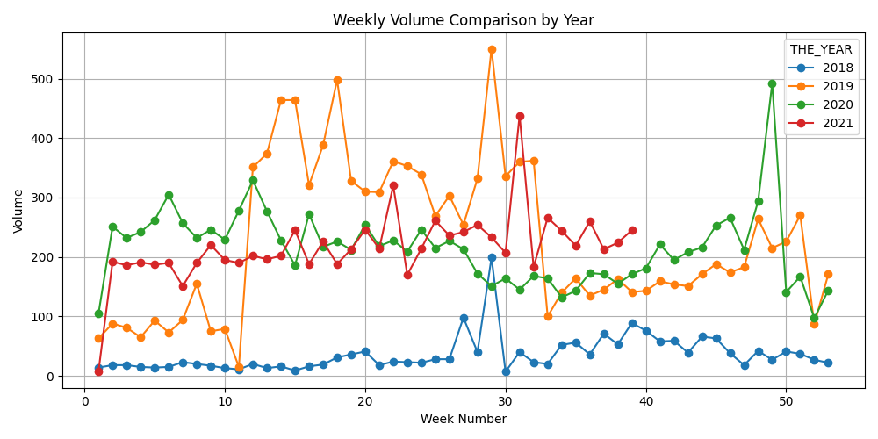
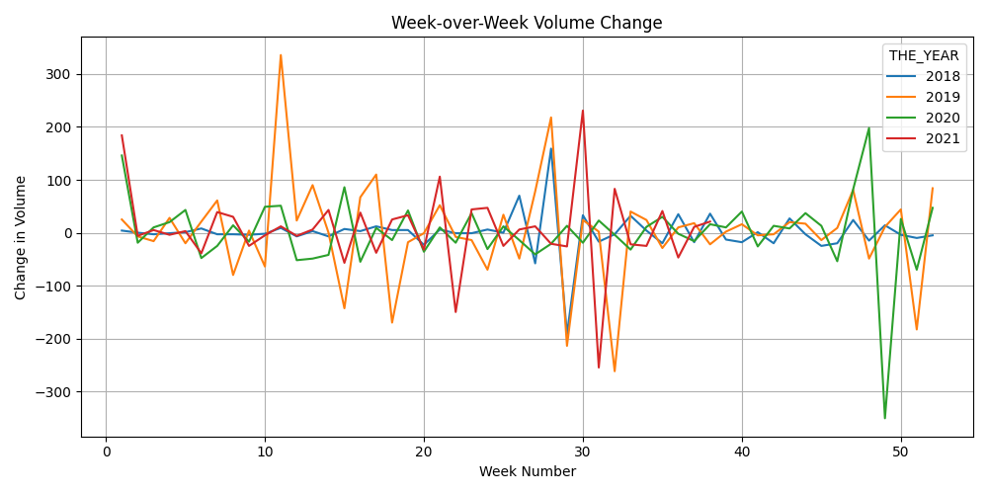
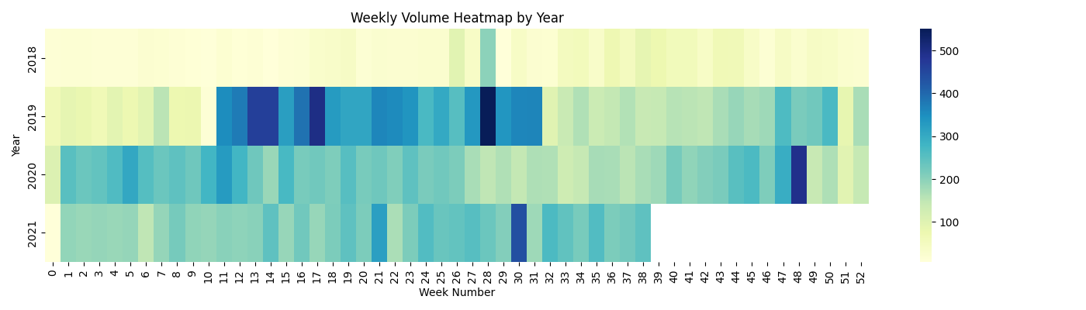
Overall Volume & Revenue Impact by Segment

Slide 13

Recommendations to Improve Business
Enhance digital onboarding for new Medium-sized customers, as they showed strong growth but also high churn.
Retarget lost 2019 customers with updated service packages or reactivation incentives.
Invest in retention strategies for Medium businesses because of being the most vulnerable group during COVID.
Strengthen support for growing Enterprise and Large clients to lock in long-term partnerships.
Prepare for seasonal surges with predictive volume planning, especially in Q4 based on 2020 trends.

Slide 14
THANK YOU

